Slide 1
Topic: On conflict free DNA codes
Krishna Gopal Benerjee · Sourav Deb · Manish K. Gupta
Name: Jitanshu Shaw
ID: 201901292
Course: IT 495 DNA Storage and Security
Guidance under:
Manish K. Gupta

Slide 2
On conflict free DNA codes
In this study, a generalisation of the non-homopolymers constraint is introduced, and it is satisfied by DNA codes. Each DNA codeword has the unique characteristic that no two consecutive substrings will ever be the same. In addition to the typical restrictions like Hamming, reverse, reverse-complement, and GC-content, there are also these. In addition to the standard restriction, there is a construction to calculate the size of DNA codes with the additional restriction that each DNA codeword be free of secondary structures.

Slide 3
Pseudo code
For n=length of the code: #length of the DNA string
if(reverse constraint is satisfied)
Then if (reverse complement constraint is satisfied)
Then if(GC content constraint is satisfied)
Then if(Conflict free)
Then if(Secondary structure constraint is satisfied)
M++; #code in codeword with for hamming distance dH=1 to dH=n;
else() delete string from the array
else() delete string from the array
else() delete string from the array
else() delete string from the array
else() delete string from the array #if any constraint aren’t matching then it will be deleted from the array

Slide 4
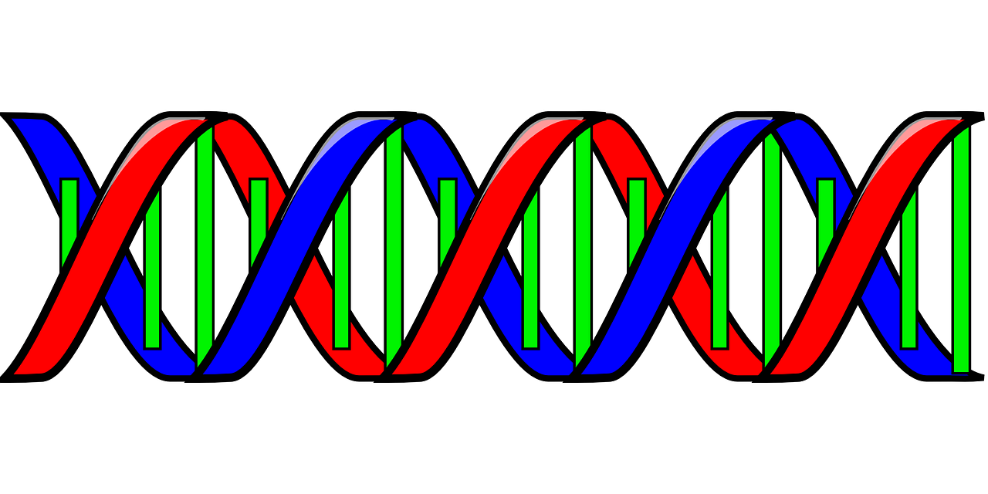
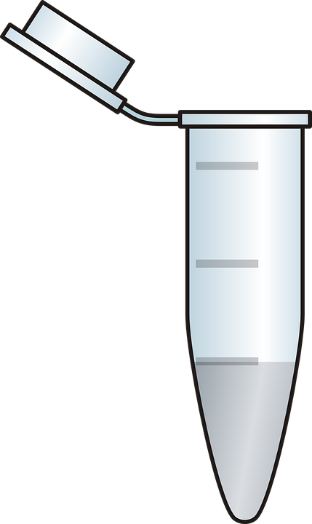
Flow Chart
.TXT
0101010101010101010011010101011011111010101100010001
AGTCGCTGAGCTTAGTACAGTCGAGTGACGATACGT
Synthesis
Encoding
Archival
DNA Storage Pool
Decoding
AGTCGCTGAGCTTAGTACAGTCGAGTGACGATACGT
Sequencing
Retrieval(PCR)
Images are taken from pixabay.com

Slide 5
Problems during
Synthesising
Sequencing

Slide 6
Constraints
Reverse constraint
Reverse complement constraint(RC constraint)
GC content constraint
Homopolymer constraint(Conflict free)
Secondary structure constraint

Slide 7
Reverse constraint
For example:-
If x= 1001001 then its reverse will be 1001001 so at time of synthesising or sequencing the probability of having an error will be increased so its not accepted.

Slide 8
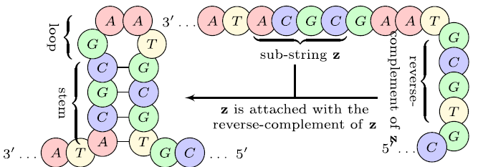
Reverse complement constraint(RC constraint)
A DNA string should not contain more than n=2 substrings which are complement to each other, or else it will form a secondary structure
For example ATACGCGAATGCGTGC this strand contains n=4 so it will form like this:

Slide 9
GC content constraint
A DNA string should contain approximately 50% of GC pair not too less or not too high, because the thermal stability of a strand depends on GC content.

Slide 10
Conflict free constraint
In a DNA string a character or a substring should repeat it self consecutively.
For example: AAAAAA, CCCCCC, ACGTACGT, ACACAC, ACGTTTGAC.
All these DNA strings or not conflict free

Slide 11
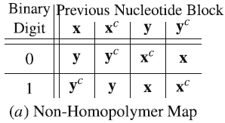
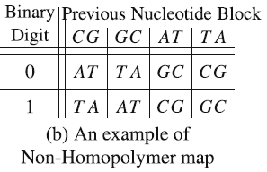
Mapping for encoding
If we take x= CG and y=AT

Slide 12
Some examples of Binary numbers are:(x=ATA, y=CGC)
0000001
1001101
1110001
0111101
0011000
0100100
ATACGCATACGCATACGCATA
TATGCGTATCGCTATGCGATA
TATCGCTATGCGTATGCGATA
ATAGCGATAGCGATACGCTAT
ATACGCTATCGCATACGCATA
ATAGCGTATGCGATACGCATA

Slide 13
My contribution
Will write a code to run this algorithm with a programming language with most of the constraint given in this paper and if possible I will try to increase the M(codewords) for given n(length of the DNA strings) for given dH(hamming distance)

Slide 14
Code(.py)
lst = []
acgtString = "ACGT"
strPred = ""
arr = ['x','x','x','x']
for one in range(0,4):
arr[0] = acgtString[one]
for two in range(0,4):
arr[1] = acgtString[two]
for three in range(0,4):
arr[2] = acgtString[three]
for four in range(0,4):
arr[3] = acgtString[four]
tempString = ""
for i in range(0,4):
tempString = tempString + arr[i]
# print(tempString)
lst.append(tempString)
print(lst)

Slide 15
Output for n=4(256 strings)
['AAAA', 'AAAC', 'AAAG', 'AAAT', 'AACA', 'AACC', 'AACG', 'AACT', 'AAGA', 'AAGC', 'AAGG', 'AAGT', 'AATA', 'AATC', 'AATG', 'AATT', 'ACAA', 'ACAC', 'ACAG', 'ACAT', 'ACCA', 'ACCC', 'ACCG', 'ACCT', 'ACGA', 'ACGC', 'ACGG', 'ACGT', 'ACTA', 'ACTC', 'ACTG', 'ACTT', 'AGAA', 'AGAC', 'AGAG', 'AGAT', 'AGCA', 'AGCC', 'AGCG', 'AGCT', 'AGGA', 'AGGC', 'AGGG', 'AGGT', 'AGTA', 'AGTC', 'AGTG', 'AGTT', 'ATAA', 'ATAC', 'ATAG', 'ATAT', 'ATCA', 'ATCC', 'ATCG', 'ATCT', 'ATGA', 'ATGC', 'ATGG', 'ATGT', 'ATTA', 'ATTC', 'ATTG', 'ATTT', 'CAAA', 'CAAC', 'CAAG', 'CAAT', 'CACA', 'CACC', 'CACG', 'CACT', 'CAGA', 'CAGC', 'CAGG', 'CAGT', 'CATA', 'CATC', 'CATG', 'CATT', 'CCAA', 'CCAC', 'CCAG', 'CCAT', 'CCCA', 'CCCC', 'CCCG', 'CCCT', 'CCGA', 'CCGC', 'CCGG', 'CCGT', 'CCTA', 'CCTC', 'CCTG', 'CCTT', 'CGAA', 'CGAC', 'CGAG', 'CGAT', 'CGCA', 'CGCC', 'CGCG', 'CGCT', 'CGGA', 'CGGC', 'CGGG', 'CGGT', 'CGTA', 'CGTC', 'CGTG', 'CGTT', 'CTAA', 'CTAC', 'CTAG', 'CTAT', 'CTCA', 'CTCC', 'CTCG', 'CTCT', 'CTGA', 'CTGC', 'CTGG', 'CTGT', 'CTTA', 'CTTC', 'CTTG', 'CTTT', 'GAAA', 'GAAC', 'GAAG', 'GAAT', 'GACA', 'GACC', 'GACG', 'GACT', 'GAGA', 'GAGC', 'GAGG', 'GAGT', 'GATA', 'GATC', 'GATG', 'GATT', 'GCAA', 'GCAC', 'GCAG', 'GCAT', 'GCCA', 'GCCC', 'GCCG', 'GCCT', 'GCGA', 'GCGC', 'GCGG', 'GCGT', 'GCTA', 'GCTC', 'GCTG', 'GCTT', 'GGAA', 'GGAC', 'GGAG', 'GGAT', 'GGCA', 'GGCC', 'GGCG', 'GGCT', 'GGGA', 'GGGC', 'GGGG', 'GGGT', 'GGTA', 'GGTC', 'GGTG', 'GGTT', 'GTAA', 'GTAC', 'GTAG', 'GTAT', 'GTCA', 'GTCC', 'GTCG', 'GTCT', 'GTGA', 'GTGC', 'GTGG', 'GTGT', 'GTTA', 'GTTC', 'GTTG', 'GTTT', 'TAAA', 'TAAC', 'TAAG', 'TAAT', 'TACA', 'TACC', 'TACG', 'TACT', 'TAGA', 'TAGC', 'TAGG', 'TAGT', 'TATA', 'TATC', 'TATG', 'TATT', 'TCAA', 'TCAC', 'TCAG', 'TCAT', 'TCCA', 'TCCC', 'TCCG', 'TCCT', 'TCGA', 'TCGC', 'TCGG', 'TCGT', 'TCTA', 'TCTC', 'TCTG', 'TCTT', 'TGAA', 'TGAC', 'TGAG', 'TGAT', 'TGCA', 'TGCC', 'TGCG', 'TGCT', 'TGGA', 'TGGC', 'TGGG', 'TGGT', 'TGTA', 'TGTC', 'TGTG', 'TGTT', 'TTAA', 'TTAC', 'TTAG', 'TTAT', 'TTCA', 'TTCC', 'TTCG', 'TTCT', 'TTGA', 'TTGC', 'TTGG', 'TTGT', 'TTTA', 'TTTC', 'TTTG', 'TTTT']

Slide 16
Code for consecutive conflict-free
new=[]
count=256 # For n=4 the length of the array will be 256
temp=count
for i in range(0,temp):
flag=1
for j in range(0, 3):
if(lst[i][j] == lst[i][j+1]):
flag=0
count-=1
break
if(flag):
new.append(lst[i]) # appending the new strings in new1

Slide 17
Output for the above code
['ACAC', 'ACAG', 'ACAT', 'ACGA', 'ACGC', 'ACGT', 'ACTA', 'ACTC', 'ACTG', 'AGAC', 'AGAG', 'AGAT', 'AGCA', 'AGCG', 'AGCT', 'AGTA', 'AGTC', 'AGTG', 'ATAC', 'ATAG', 'ATAT', 'ATCA', 'ATCG', 'ATCT', 'ATGA', 'ATGC', 'ATGT', 'CACA', 'CACG', 'CACT', 'CAGA', 'CAGC', 'CAGT', 'CATA', 'CATC', 'CATG', 'CGAC', 'CGAG', 'CGAT', 'CGCA', 'CGCG', 'CGCT', 'CGTA', 'CGTC', 'CGTG', 'CTAC', 'CTAG', 'CTAT', 'CTCA', 'CTCG', 'CTCT', 'CTGA', 'CTGC', 'CTGT', 'GACA', 'GACG', 'GACT', 'GAGA', 'GAGC', 'GAGT', 'GATA', 'GATC', 'GATG', 'GCAC', 'GCAG', 'GCAT', 'GCGA', 'GCGC', 'GCGT', 'GCTA', 'GCTC', 'GCTG', 'GTAC', 'GTAG', 'GTAT', 'GTCA', 'GTCG', 'GTCT', 'GTGA', 'GTGC', 'GTGT', 'TACA', 'TACG', 'TACT', 'TAGA', 'TAGC', 'TAGT', 'TATA', 'TATC', 'TATG', 'TCAC', 'TCAG', 'TCAT', 'TCGA', 'TCGC', 'TCGT', 'TCTA', 'TCTC', 'TCTG', 'TGAC', 'TGAG', 'TGAT', 'TGCA', 'TGCG', 'TGCT', 'TGTA', 'TGTC', 'TGTG']

Slide 18
Code for completely conflict-free
new1=[]
temp=count
for i in range(0,temp):
flag=0
for j in range(0, 2):
if(new[i][j] != new[i][j+2]):
flag=1
break
if(flag):
new1.append(new[i])
else:
count-=1

Slide 19
Output for the above code
['ACAG', 'ACAT', 'ACGA', 'ACGC', 'ACGT', 'ACTA', 'ACTC', 'ACTG', 'AGAC', 'AGAT', 'AGCA', 'AGCG', 'AGCT', 'AGTA', 'AGTC', 'AGTG', 'ATAC', 'ATAG', 'ATCA', 'ATCG', 'ATCT', 'ATGA', 'ATGC', 'ATGT', 'CACG', 'CACT', 'CAGA', 'CAGC', 'CAGT', 'CATA', 'CATC', 'CATG', 'CGAC', 'CGAG', 'CGAT', 'CGCA', 'CGCT', 'CGTA', 'CGTC', 'CGTG', 'CTAC', 'CTAG', 'CTAT', 'CTCA', 'CTCG', 'CTGA', 'CTGC', 'CTGT', 'GACA', 'GACG', 'GACT', 'GAGC', 'GAGT', 'GATA', 'GATC', 'GATG', 'GCAC', 'GCAG', 'GCAT', 'GCGA', 'GCGT', 'GCTA', 'GCTC', 'GCTG', 'GTAC', 'GTAG', 'GTAT', 'GTCA', 'GTCG', 'GTCT', 'GTGA', 'GTGC', 'TACA', 'TACG', 'TACT', 'TAGA', 'TAGC', 'TAGT', 'TATC', 'TATG', 'TCAC', 'TCAG', 'TCAT', 'TCGA', 'TCGC', 'TCGT', 'TCTA', 'TCTG', 'TGAC', 'TGAG', 'TGAT', 'TGCA', 'TGCG', 'TGCT', 'TGTA', 'TGTC']

Slide 20
GC constraint code
temp=count
new2=[]
for i in range(0,temp):
flag=0
for j in range(0, 3):
if(new1[i][j] == 'G' and new1[i][j+1] == 'C'):
flag=1
break
if(flag):
new2.append(new1[i])
else:
count-=1

Slide 21
Final output after taking every constraint
['ACGC', 'AGCA', 'AGCG', 'AGCT', 'ATGC', 'CAGC', 'CGCA', 'CGCT', 'CTGC', 'GAGC', 'GCAC', 'GCAG', 'GCAT', 'GCGA', 'GCGT', 'GCTA', 'GCTC', 'GCTG', 'GTGC', 'TAGC', 'TCGC', 'TGCA', 'TGCG', 'TGCT']

Slide 22
The previous slide contains the final strings for n=4 which will be used for encoding.

Slide 23
Function for counting hamming distance
def hamming(string1, string2):
d = 0
L = len(string1)
for i in range(L):
if string1[i] != string2[i]:
d += 1
return d # Returning the final

Slide 24
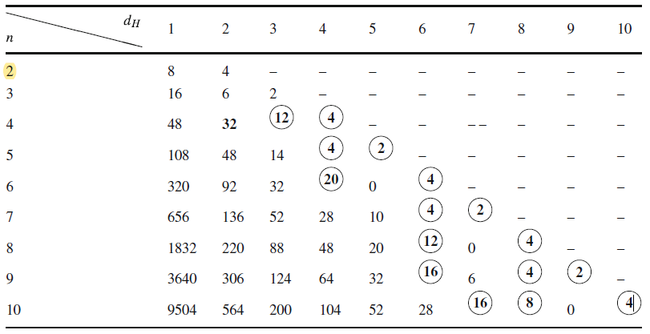
Table

Slide 25
Thank You!

